Slide 1
Designing Architectures
Theme: how architectures are created
Software Architecture
Lecture 4

Slide 2
How Do You Design?
Where do architectures come from?
Creativity
Efficient in familiar environment
Not always successful
Predictable outcome (+ & - )
Quality of methods varies
Fun!
Troubled with risks
May be unnecessary
May yield the best
Method

Slide 3
Objectives
Creativity
  Enhance your skillset
  Provide new tools
Method
  Focus on highly effective techniques
Develop judgment: when to develop novel solutions, and when to follow established method

Slide 4
Engineering Design Process (std. Approach)
Feasibility stage: identifying a set of feasible concepts for the design as a whole
Preliminary design stage: selection and development of the best concept.
Detailed design stage: development of engineering descriptions of the concept.
Planning stage: evaluating and altering the concept to suit the requirements of production (what), distribution(Who), consumption(how) and product retirement(When).

Slide 5
Potential Problems
If the designer is unable to produce a set of feasible concepts, progress stops.
As problems and products increase in size and complexity, the probability that any one individual can successfully perform the first steps decreases.
The standard approach does not directly address the situation where system design is at stake
→ As complexity increases or the experience of the designer is not sufficient, alternative approaches to the design process must be adopted.

Slide 6
Alternative Design Strategies
Standard
  Linear model described above
Cyclic
  Process can revert to an earlier stage
Parallel
  Independent alternatives are explored in parallel after first stage.
Adaptive (“lay tracks as you go”)
  The next design strategy of the design activity is decided at the end of a given stage
Incremental
  Each stage of development is treated as a task of incrementally improving the existing design

Slide 7
Identifying a Viable Strategy
Use fundamental design tools: abstraction and modularity.
  But how? (Process available FRs and NFRs)
Creativity is required needed method based approaches does not fulfill needs. (example of Plaza)
Applying own experience or experience of others.

Slide 8
The Tools of “Software Engineering 101”
Abstraction
  Abstraction(1): look at details, and abstract “up” to concepts
  Abstraction(2): choose concepts, then add detailed substructure, and move “down”
Separation of concerns
Notes:
First view is the standard (dictionary) understanding
Second view is how CS people think of it; it is top-down design (you’re always betting on the chance that you’ll be able to come up with a workable substructure)

Slide 9
A Few Definitions… from the Oxford English Dictionary Online
Abstraction: “The act or process of considering a substance independently of its attributes; e.g., @bird’s eye view
Reification: “The mental conversion of … [an] abstract concept into a thing.” e.g., 1) layers to subsystems to components to classes to function and variables 2) twin-peak model
Deduction: “The process of drawing a conclusion from a principle already known or assumed; spec. in Logic, inference by reasoning from generals to particulars; opposed to INDUCTION.” e.g., using inheritance, polymorphism, encapsulation and abstraction
Induction: “The process of inferring a general law or principle from the observation of particular instances (opposed to DEDUCTION, q.v.).” e.g., machine learning models training
Notes:
abstraction hides the code complexity while encapsulation hides the internal working from the outside world.

Slide 10
Abstraction and the Simple Machines
What concepts should be chosen at the outset of a design task?
  One technique: Search for a “simple machine” that serves as an abstraction of a potential system that will perform the required task
  For instance, what kind of simple machine makes a software system embedded in a fax machine?
    At core, it is basically just a little state machine.
Simple machines provide a reasonable first conception of how an application might be built.
Every application domain has its common simple machines.
Notes:
https://www.britannica.com/technology/fax

Slide 11
Simple Machines
Domain | Simple Machines
Graphics | Pixel arrays Transformation matrices Widgets Abstract depiction graphs
Word processing | Structured documents Layouts
Process control | Finite state machines
Income Tax Software | Hypertext Spreadsheets Form templates
Web pages | Hypertext Composite documents
Scientific computing | Matrices Mathematical functions
Banking | Spreadsheets Databases Transactions

Slide 12
Separation of Concerns
Separation of concerns is the subdivision of a problem into (hopefully) independent parts.
The difficulties arise when the issues are either actually or apparently intertwined.
Separations of concerns frequently involves many tradeoffs
Total independence of concepts may not be possible.
Key example from software architecture: separation of components (computation) from connectors (communication)

Slide 13
The Grand Tool: Refined Experience
Experience must be reflected upon and refined.
The lessons from prior work include not only the lessons of successes, but also the lessons arising from failure.
Learn from success and failure of other engineers
  Literature
  Conferences
Experience can provide that initial feasible set of “alternative arrangements for the design as a whole”.

Slide 14
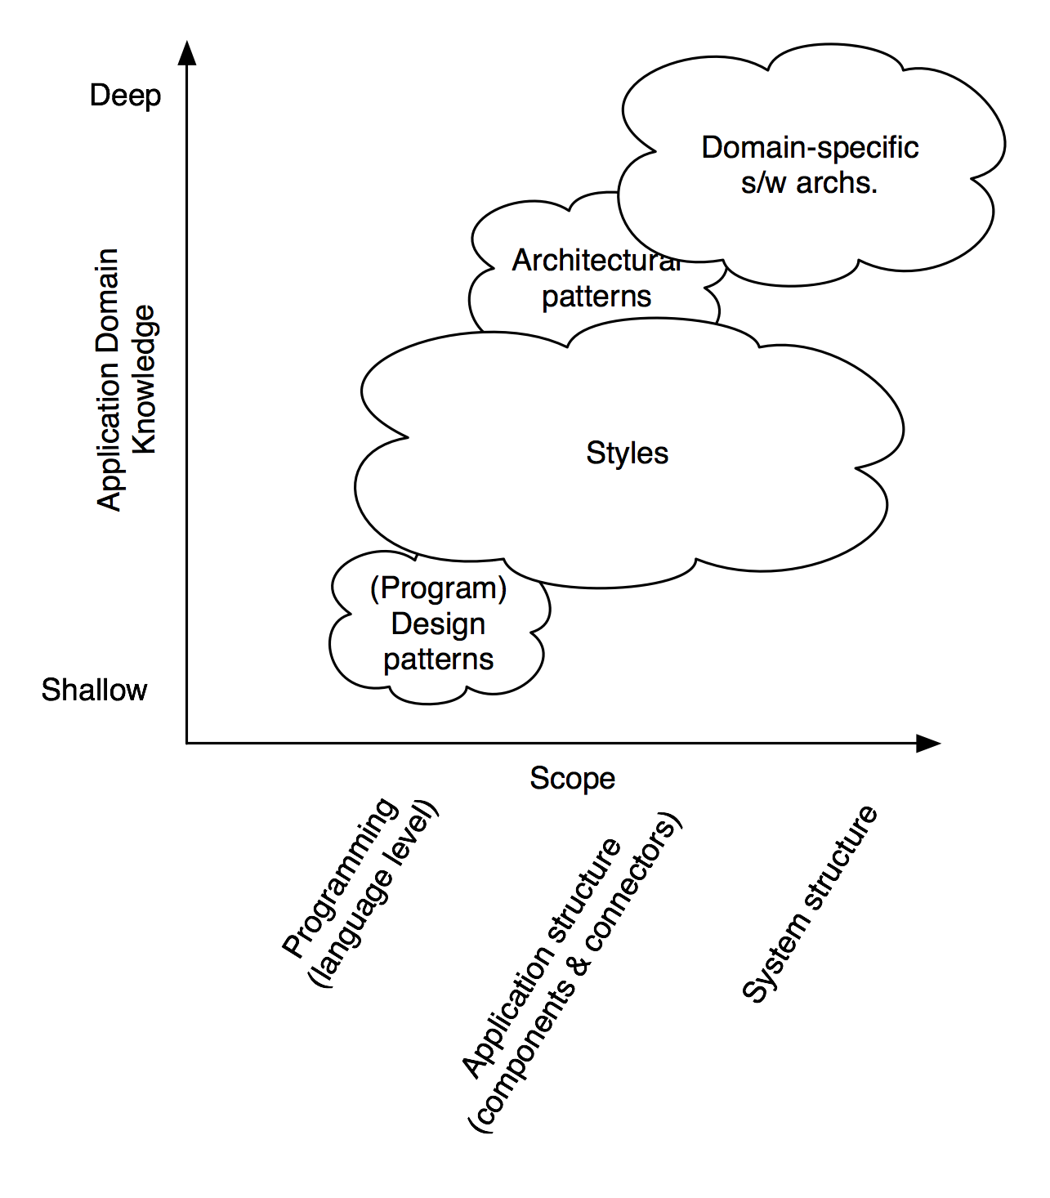
Patterns, Styles, and DSSAs
Software Architecture: Foundations, Theory, and Practice; Richard N. Taylor, Nenad Medvidovic, and Eric M. Dashofy; © 2008 John Wiley & Sons, Inc. Reprinted with permission.

Slide 15
Domain-Specific Software Architectures
A DSSA is an assemblage of software components
  specialized for a particular type of task (domain),
  generalized for effective use across that domain, and
  composed in a standardized structure (topology) effective for building successful applications.
DSSAs are of value when the engineer is tasked with building a new application.
DSSAs are the pre-eminent means for maximal reuse of knowledge and prior development and hence for developing a new architectural design.

Slide 16
Architectural Patterns
An architectural pattern is a set of architectural design decisions that are applicable to a recurring design problem, and parameterized to account for different software development contexts in which that problem appears.
Architectural patterns are similar to DSSAs but applied “at a lower level” and within a much narrower scope.

Slide 17
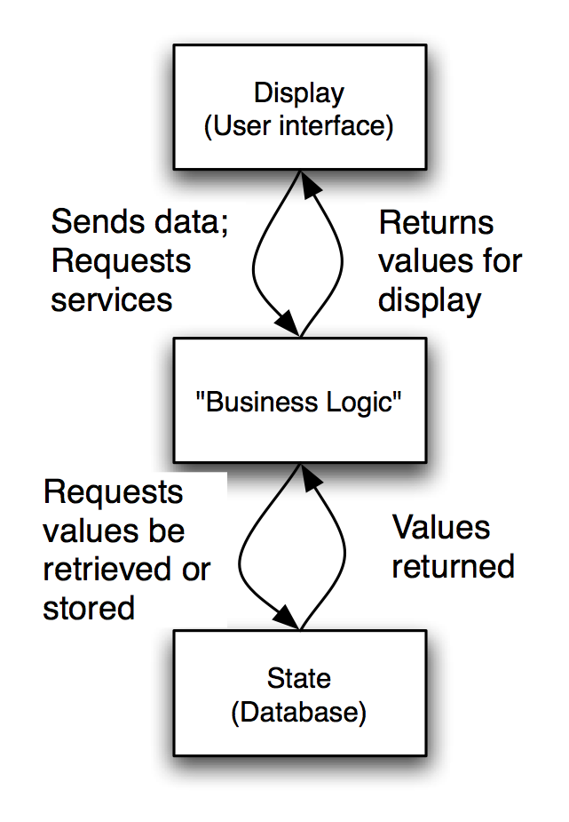
State-Logic-Display: Three-Tiered Pattern
Application Examples
  Business applications
  Multi-player games
  Web-based applications
Software Architecture: Foundations, Theory, and Practice; Richard N. Taylor, Nenad Medvidovic, and Eric M. Dashofy; © 2008 John Wiley & Sons, Inc. Reprinted with permission.

Slide 18
Model-View-Controller (MVC)
Objective: Separation between information, presentation and user interaction.
-MVC is an architectural pattern consisting of three parts:
Model: Handles data logic.
View: It displays the information from the model to the user.
Controller: It controls the data flow into a model object and updates the view whenever data changes.

Slide 19
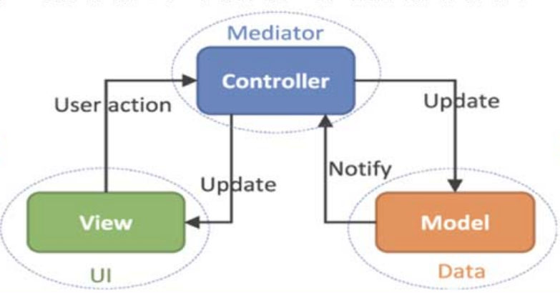
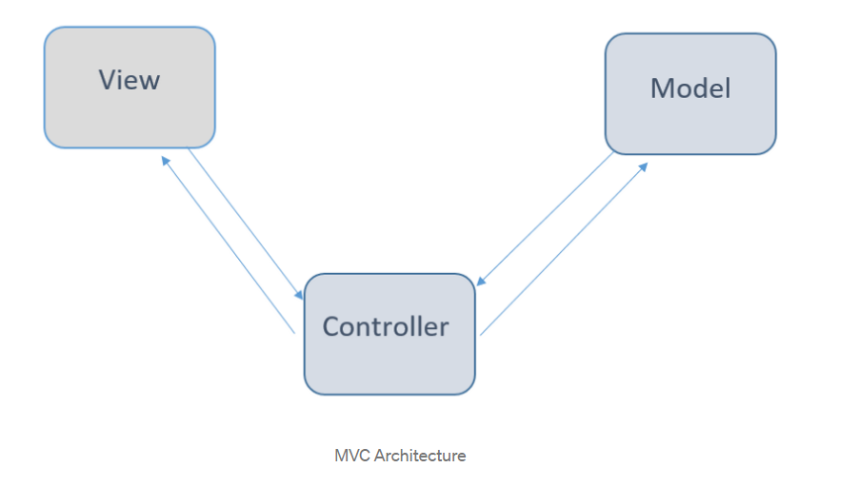
Model-View-Controller
Software Architecture: Foundations, Theory, and Practice; Richard N. Taylor, Nenad Medvidovic, and Eric M. Dashofy; © 2008 John Wiley & Sons, Inc. Reprinted with permission.
Notes:
Draw a graph as an example
Graph drawn as circles and lines
Graph drawn as a bit matrix: a 1 indicates that those two nodes (x, y) are connected

Slide 20
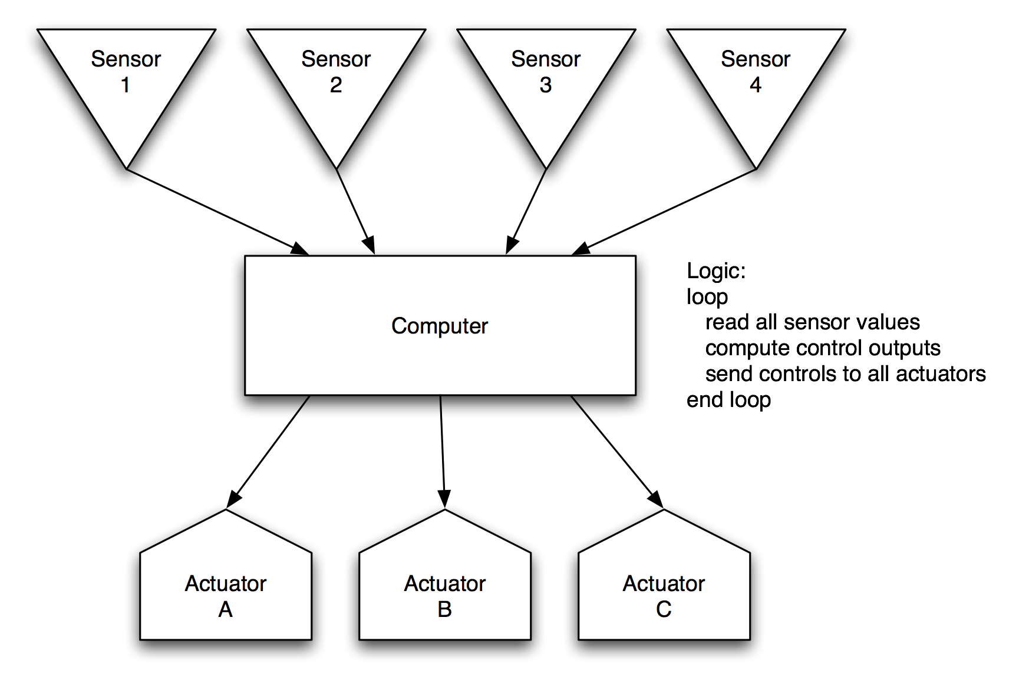
Sense-Compute-Control
Objective: Structuring embedded control applications
Software Architecture: Foundations, Theory, and Practice; Richard N. Taylor, Nenad Medvidovic, and Eric M. Dashofy; © 2008 John Wiley & Sons, Inc. Reprinted with permission.

Slide 21
The Lunar Lander: A Long-Running Example
A simple computer game that first appeared in the 1960’s
Simple concept:
  You (the pilot) control the descent rate of the Apollo-era Lunar Lander
    Throttle setting controls descent engine
    Limited fuel
    Initial altitude and speed preset
    If you land with a descent rate of < 5 fps: you win (whether there’s fuel left or not)
  “Advanced” version: joystick controls attitude & horizontal motion

Slide 22
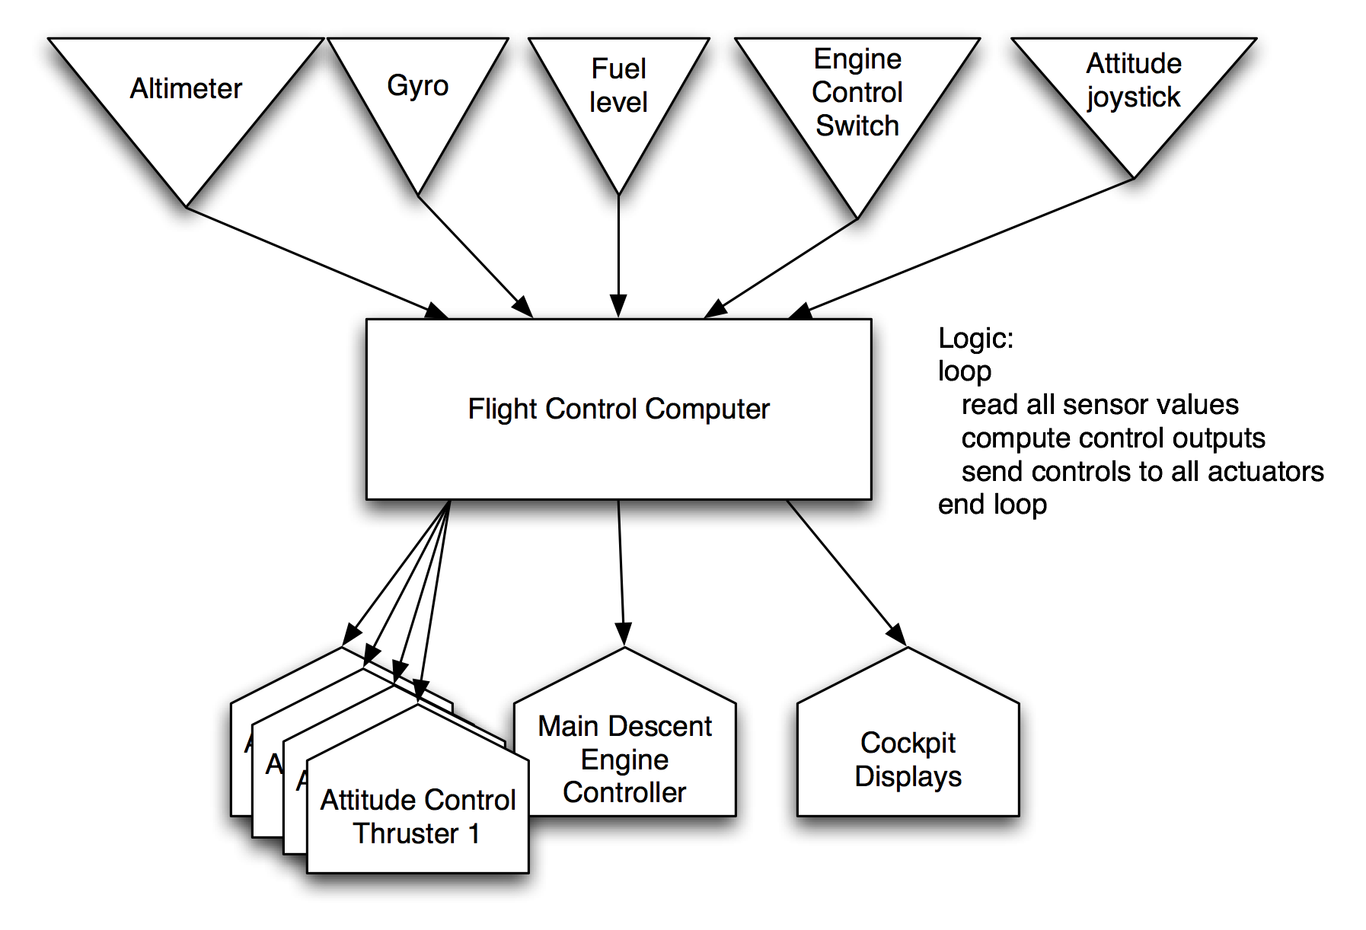
Sense-Compute-Control LL
Software Architecture: Foundations, Theory, and Practice; Richard N. Taylor, Nenad Medvidovic, and Eric M. Dashofy; © 2008 John Wiley & Sons, Inc. Reprinted with permission.
Notes:
An altimeter or an altitude meter is an instrument used to measure the altitude of an object above a fixed level.
Gyro sensors, also known as angular rate sensors or angular velocity sensors, are devices that sense angular velocity. Accelerometers and Gyroscopes compliment each other so, they are usually used together. An accelerometer measures the linear acceleration or directional movement of an object

Slide 23
Architectural Styles
An architectural style is a named collection of architectural design decisions that
    are applicable in a given development context
    constrain architectural design decisions that are specific to a particular system within that context
    elicit beneficial qualities in each resulting system
A primary way of characterizing lessons from experience in software system design
Reflect less domain specificity than architectural patterns
Useful in determining everything from subroutine structure to top-level application structure

Slide 24
Definitions of Architectural Style
Recurring organizational patterns
  Established, shared understanding of common design forms
  Mark of mature engineering field.
    Shaw & Garlan
Abstraction of recurring composition & interaction characteristics in a set of architectures
    Taylor

Slide 25
Basic Properties of Styles
A vocabulary of design elements
  Component and connector types; data elements
  e.g., pipes, filters, objects, servers
A set of configuration rules
  Topological constraints that determine allowed compositions of elements
  e.g., a component may be connected to at most two other components
A semantic interpretation
  Compositions of design elements have well-defined meanings
Possible analyses of systems built in a style

Slide 26
Benefits of Using Styles
Design reuse
  Well-understood solutions applied to new problems
Code reuse
  Shared implementations of invariant aspects of a style
Understandability of system organization
  A phrase such as “client-server” conveys a lot of information
Interoperability
  Supported by style standardization
Style-specific analyses
  Enabled by the constrained design space
Visualizations
  Style-specific depictions matching engineers’ mental models

Slide 27
Style Analysis Dimensions
What is the design vocabulary?
  Component and connector types
What are the allowable structural patterns?
What is the underlying computational model?
What are the essential invariants of the style?
What are common examples of its use?
What are the (dis)advantages of using the style?
What are the style’s specializations?

Slide 28
Some Common Styles
Traditional, language-influenced styles
  Main program and subroutines
  Object-oriented
Layered
  Virtual machines
  Client-server
Data-flow styles
  Batch sequential
  Pipe and filter
Shared memory
  Blackboard
  Rule based
Interpreter
  Interpreter
  Mobile code
Implicit invocation
  Event-based
  Publish-subscribe
Peer-to-peer
“Derived” styles
  C2
  CORBA

Slide 29
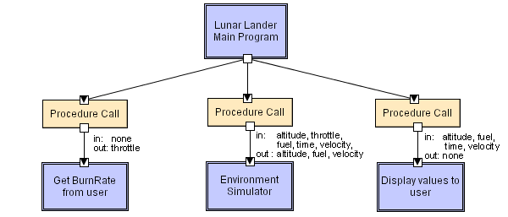
Main Program and Subroutines LL
Software Architecture: Foundations, Theory, and Practice; Richard N. Taylor, Nenad Medvidovic, and Eric M. Dashofy; © 2008 John Wiley & Sons, Inc. Reprinted with permission.
Notes:
Main program displays greetings and instructions, then enters a loop in which it calls the three subroutines in turn.

